Slide 1
NoSQL Databases (18CS823) (Module 5)
Presenter:
Mrs. Ancy Thomas
Assistant Professor
Department of Computer Science and Engineering
Acharya Institute of Technology

Slide 2
NoSQL: Graph Databases
Module 5 – Chapter 11

Slide 3
What is a Graph?

Slide 4

What is a Graph?
An abstract representation of a set of objects where some pairs are connected by links.
Object (Vertex, Node)
Link (Edge, Arc, Relationship)

Slide 5




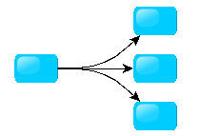
Different Kinds of Graphs
Undirected Graph
Directed Graph
Pseudo Graph
Multi Graph
Hyper Graph
Notes:
An undirected graph is one in which edges have no orientation. The edge (a, b) is identical to the edge (b, a).
A directed graph or digraph is an ordered pair D = (V, A)
A pseudo graph is a graph with loops
A multi graph allows for multiple edges between nodes
A hyper graph allows an edge to join more than two nodes

Slide 6



More Kinds of Graphs
Weighted Graph
Labeled Graph
Property Graph
Notes:
A weighted graph has a number assigned to each edge
A labeled graph has a label assigned to each node or edge
A property graph has keys and values for each node or edge

Slide 7
What is a Graph Database?
A database with an explicit graph structure
Each node knows its adjacent nodes
As the number of nodes increases, the cost of a local step (or hop) remains the same
Plus an Index for lookups

Slide 8
Graph Databases
Graph databases allow you to store entities and relationships between these entities.
Entities are also known as nodes, which have properties.
Think of a node as an instance of an object in the application.
Relations are known as edges that can have properties.
Edges have directional significance; nodes are organized by relationships which allow you to find interesting patterns between the nodes.
The organization of the graph lets the data to be stored once and then interpreted in different ways based on relationships.

Slide 9
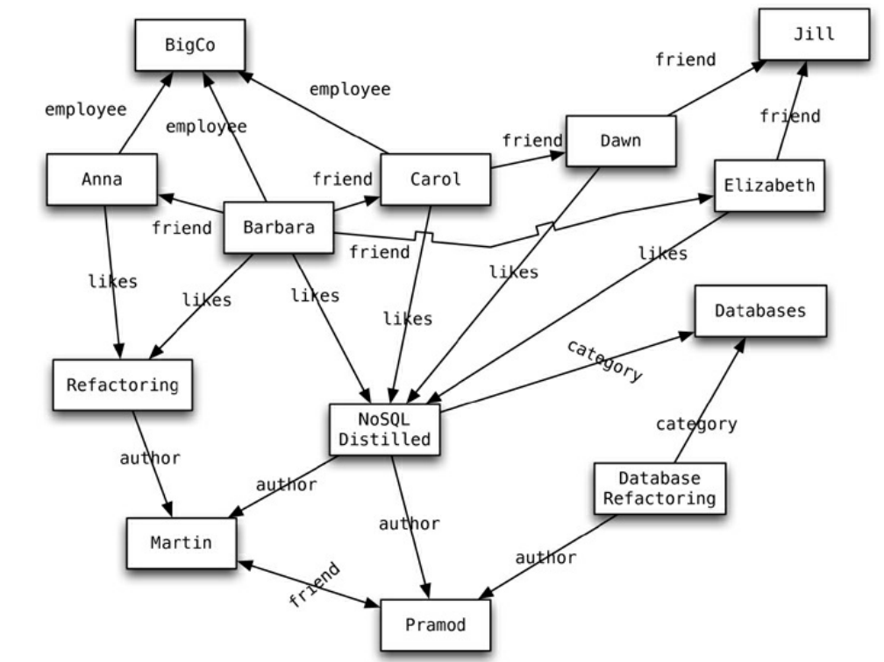
Graph Databases - Example
Figure 11.1. An example graph structure

Slide 10
In the example graph in Figure 11.1, a bunch of nodes related to each other.
Nodes are entities that have properties, such as name.
The node of Martin is actually a node that has property of name set to Martin.
Edges have types, such as likes, author, and so on. These properties let us organize the nodes; for example, the nodes Martin and Pramod have an edge connecting them with a relationship type of friend.
Edges can have multiple properties - assign a property of since on the friend relationship type between Martin and Pramod.
Relationship types have directional significance;
The friend relationship type is bidirectional but likes is not. When Dawn likes NoSQL Distilled, it does not automatically mean NoSQL Distilled likes Dawn.

Slide 11
Once we have a graph of these nodes and edges created, we can query the graph in many ways, such as “get all nodes employed by BigCo that like NoSQL Distilled.”
A query on the graph is also known as traversing the graph.
An advantage of the graph databases is that we can change the traversing requirements without having to change the nodes or edges.
If we want to “get all nodes that like NoSQL Distilled,” we can do so without having to change the existing data or the model of the database, because we can traverse the graph any way we like.

Slide 12
In graph databases, traversing the joins or relationships is very fast.
The relationship between nodes is not calculated at query time but is actually persisted as a relationship.
Traversing persisted relationships is faster than calculating them for every query.
Nodes can have different types of relationships between them, allowing you to both represent relationships between the domain entities and to have secondary relationships for things like category, path, time-trees, quad-trees for spatial indexing, or linked lists for sorted access.
Since there is no limit to the number and kind of relationships a node can have, all they can be represented in the same graph database.

Slide 13
Features
Consistency
Transactions
Availability
Query features
Scaling

Slide 14
Neo4J is taken as a representative of the graph database solutions to discuss how they work and how they can be used to solve application In
Neo4J, creating a graph is as simple as creating two nodes and then creating a relationship.
Example - Let’s create two nodes, Martin and Pramod:
Node martin = graphDb.createNode(); martin.setProperty("name", "Martin");
Node pramod = graphDb.createNode(); pramod.setProperty("name", "Pramod");
Create a relationship:
martin.createRelationshipTo(pramod,FRIEND); pramod.createRelationshipTo(martin, FRIEND);

Slide 15
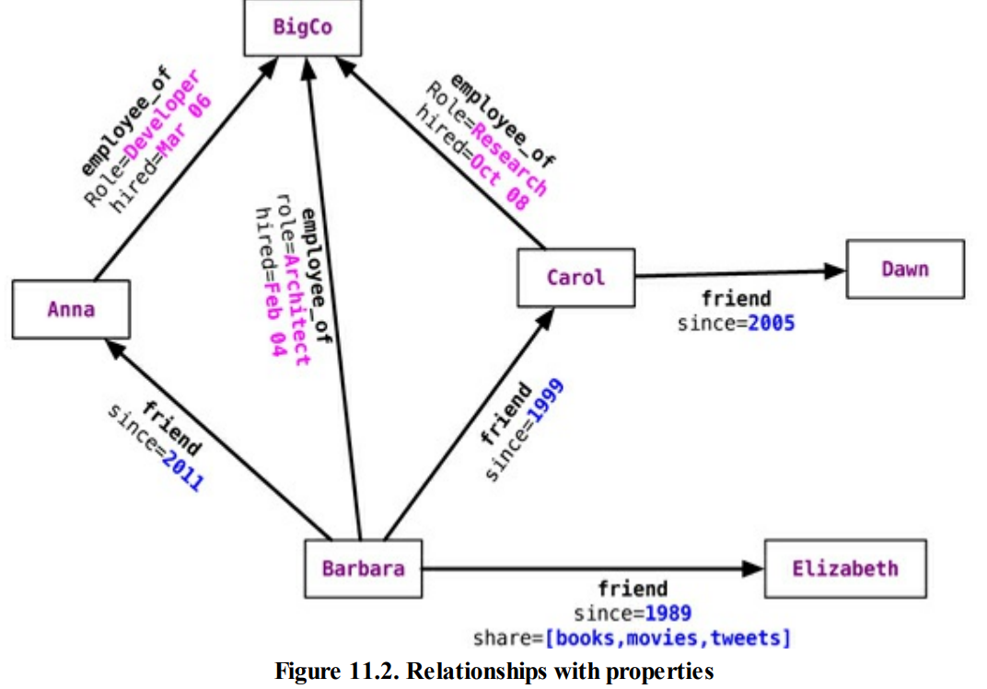

Slide 16
1. Consistency
Since graph databases are operating on connected nodes, most graph database solutions usually do not support distributing the nodes on different servers.
Within a single server, data is always consistent, especially in Neo4J which is fully ACID-compliant.
When running Neo4J in a cluster, a write to the master is eventually synchronized to the slaves, while slaves are always available for read.
Writes to slaves are allowed and are immediately synchronized to the master; other slaves will not be synchronized immediately, though—they will have to wait for the data to propagate from the master.
Graph databases ensure consistency through transactions. They do not allow dangling relationships: The start node and end node always have to exist, and nodes can only be deleted if they don’t have any relationships attached to them.

Slide 17
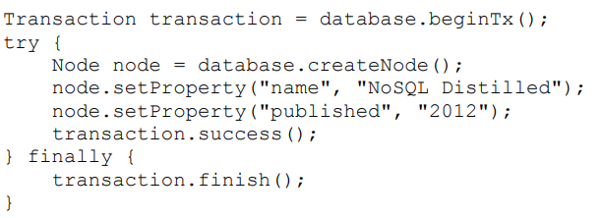
Transactions
Neo4J is ACID-compliant.
Before changing any nodes or adding any relationships to existing nodes, we have to start a transaction.
Without wrapping operations in transactions, we will get a NotInTransactionException.
Read operations can be done without initiating a transaction.

Slide 18
Availability
Neo4J, as of version 1.8, achieves high availability by providing for replicated slaves.
These slaves can also handle writes: When they are written to, they synchronize the write to the current master, and the write is committed first at the master and then at the slave.
Other slaves will eventually get the update.
Other graph databases, such as Infinite Graph and FlockDB, provide for distributed storage of the nodes.
Neo4J uses the Apache ZooKeeper to keep track of the last transaction IDs persisted on each slave node and the current master node.
Once a server starts up, it communicates with ZooKeeper and finds out which server is the master.
If the server is the first one to join the cluster, it becomes the master; when a master goes down, the cluster elects a master from the available nodes, thus providing high availability.

Slide 19
Query Features
Graph databases are supported by query languages such as Gremlin.
Gremlin is a domain specific language for traversing graphs; it can traverse all graph databases that implement the Blueprints property graph.
Neo4J also has the Cypher query language for querying the graph.
Outside these query languages, Neo4J allows you to query the graph for properties of the nodes, traverse the graph, or navigate the nodes relationships using language bindings
Properties of a node can be indexed using the indexing service. Similarly, properties of relationships or edges can be indexed, so a node or edge can be found by the value.
Indexes should be queried to find the starting node to begin a traversal.

Slide 20
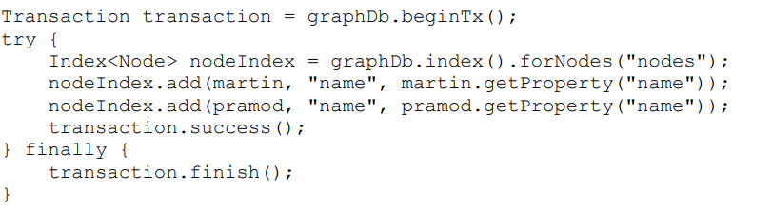
Query Features
Create an index for the nodes using the IndexManager.
Index nodeIndex = graphDb.index().forNodes("nodes");
We are indexing the nodes for the name property. Neo4J uses Lucene as its indexing service.
When new nodes are created, they can be added to the index.

Slide 21
Adding nodes to the index is done inside the context of a transaction.
Once the nodes are indexed, we can search them using the indexed property.
If we search for the node with the name of Barbara, we would query the index for the property of name to have a value of Barbara.
Node node = nodeIndex.get("name", "Barbara").getSingle();

Slide 22
We get the node whose name is Martin; given the node, we can get all its relationships.(see figure 11.1 slide 8)
Node martin = nodeIndex.get("name", "Martin").getSingle();
allRelationships = martin.getRelationships();
We can get both INCOMING or OUTGOING relationships.
incomingRelations =
martin.getRelationships(Direction.INCOMING);

Slide 23
We can also apply directional filters on the queries when querying for a relationship. With the graph in Figure 11.1, if we want to find all people who like NoSQL Distilled, we can find the NoSQL Distilled node and then get its relationships with Direction.INCOMING.
At this point we can also add the type of relationship to the query filter, since we are looking only for nodes that LIKE NoSQL Distilled.
Node nosqlDistilled = nodeIndex.get("name", "NoSQL Distilled").getSingle();
relationships = nosqlDistilled.getRelationships(INCOMING, LIKES);
for (Relationship relationship : relationships)
{
likesNoSQLDistilled.add(relationship.getStartNode());
}

Slide 24
To find all the nodes at any depth that are related as a FRIEND with Barbara:
Node barbara = nodeIndex.get("name", "Barbara").getSingle();
Traverser friendsTraverser = barbara.traverse(Order.BREADTH_FIRST, StopEvaluator.END_OF_GRAPH, ReturnableEvaluator.ALL_BUT_START_NODE, EdgeType.FRIEND, Direction.OUTGOING);

Slide 25
Graph Databases: Pros and Cons
Pros:
Powerful data model, as general as RDBMS
Connected data locally indexed
Easy to query
Cons
Sharding ( lots of people working on this)
Scales UP reasonably well
Requires rewiring your brain

Slide 26
What are graphs good for?
Recommendations
Business intelligence
Social computing
Geospatial
Systems management
Web of things
Genealogy
Time series data
Product catalogue
Web analytics
Scientific computing (especially bioinformatics)
Indexing your slow RDBMS
And much more!

Slide 27
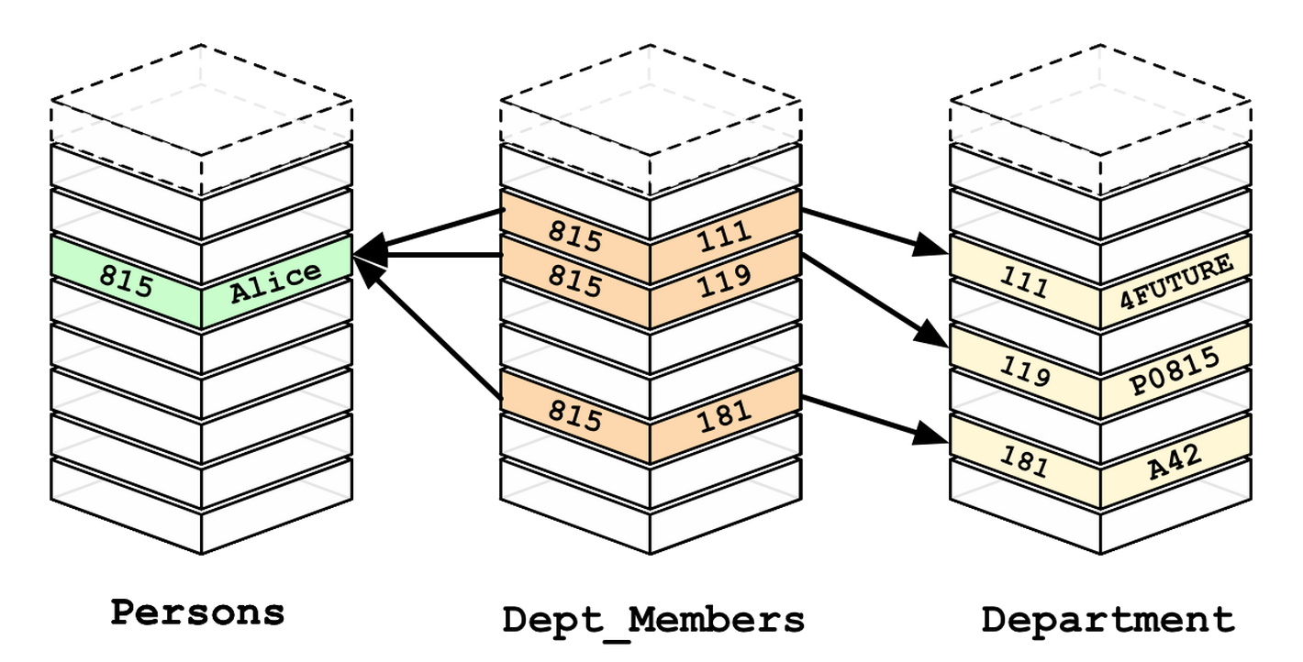
Relational Databases

Slide 28
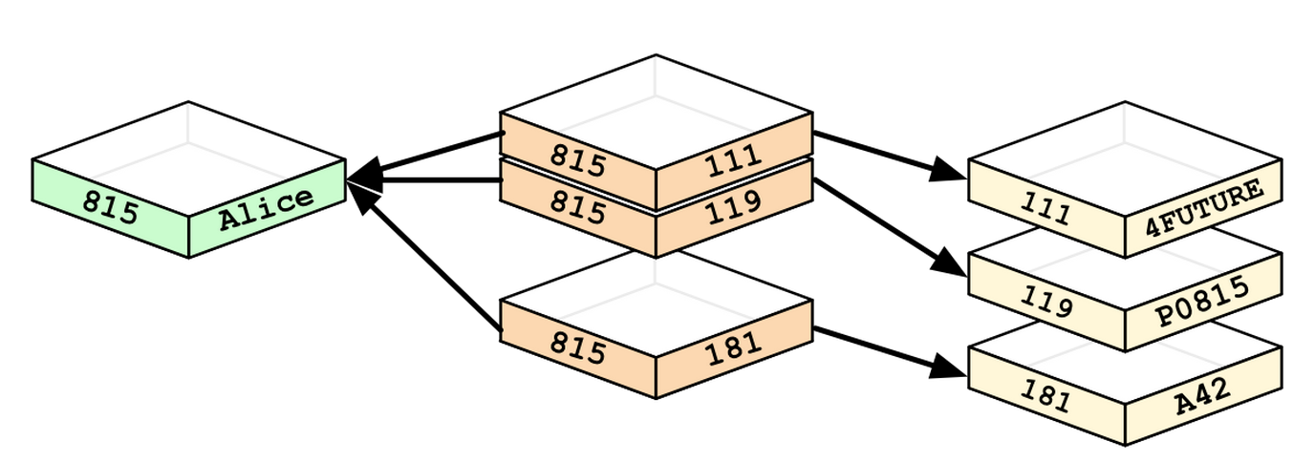
Graph Databases

Slide 29
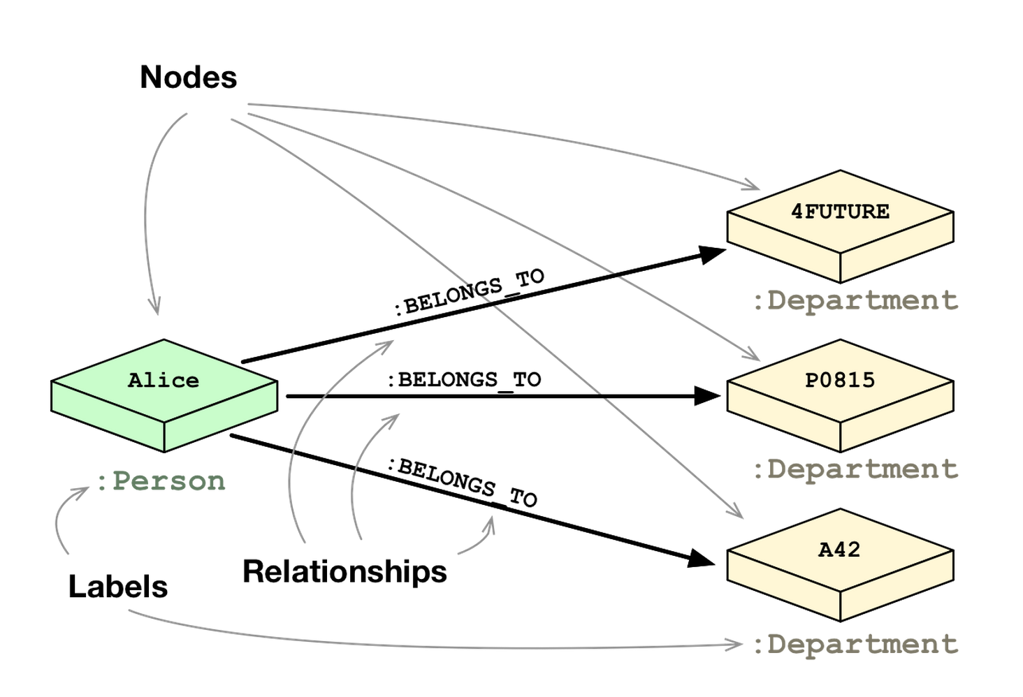

Slide 30
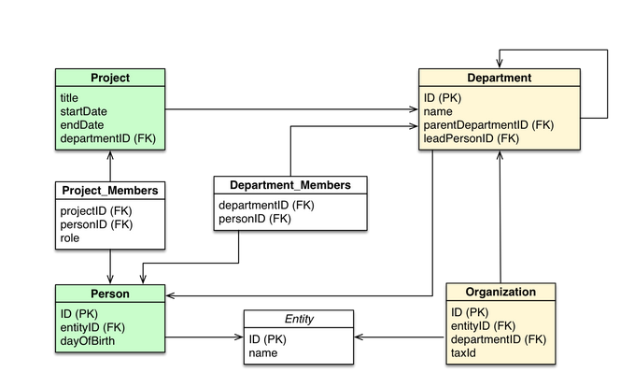

Slide 31
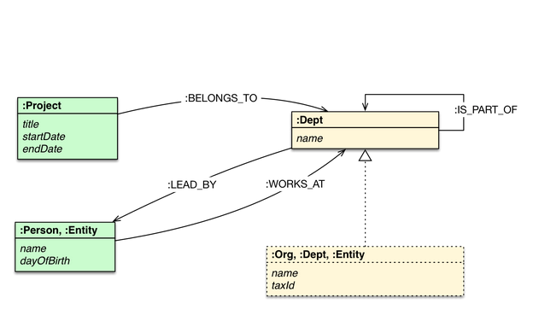

Slide 32
Neo4j Tips
Each entity table is represented by a label on nodes
Each row in a entity table is a node
Columns on those tables become node properties.
Join tables are transformed into relationships, columns on those tables become relationship properties

Slide 33
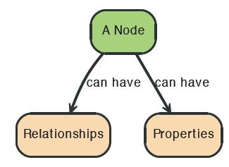

Node in Neo4j

Slide 34
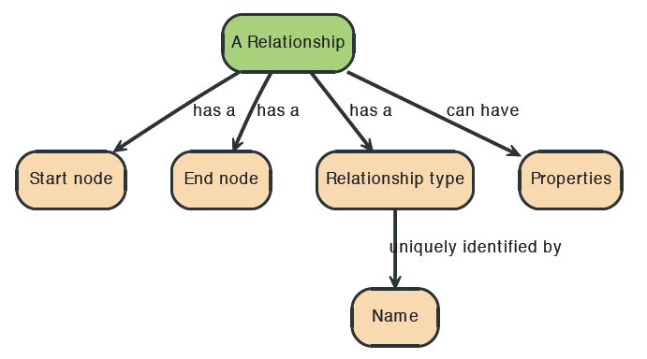
Relationships in Neo4j
Relationships between nodes are a key part of Neo4j.

Slide 35



Relationships in Neo4j

Slide 36
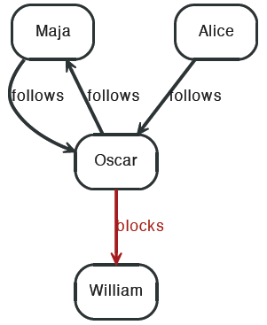


Twitter and relationships

Slide 37
Properties
Both nodes and relationships can have properties.
Properties are key-value pairs where the key is a string.
Property values can be either a primitive or an
array of one primitive type.
For example String, int and int[] values are valid for properties.

Slide 38
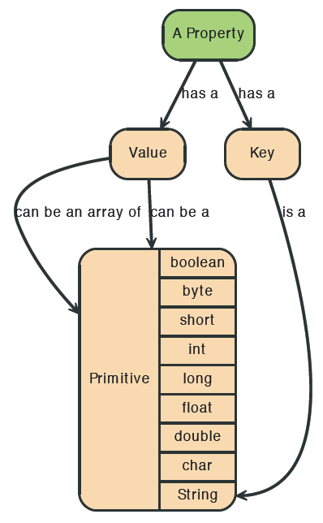
Properties

Slide 39
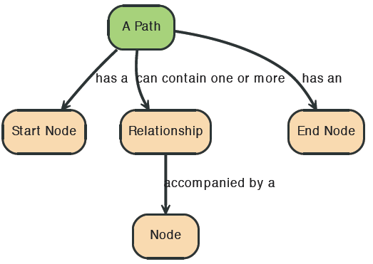

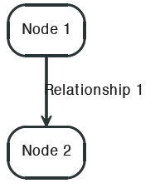
Paths in Neo4j
A path is one or more nodes with connecting relationships, typically retrieved as a query or traversal result.

Slide 40

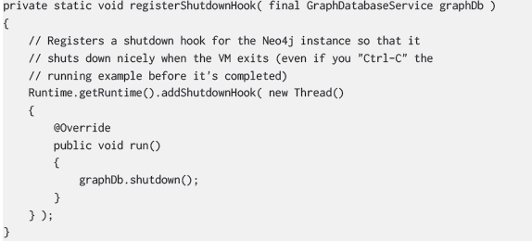
Starting and Stopping

Slide 41
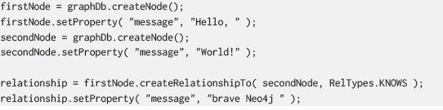
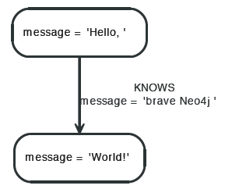
Creating a small graph

Slide 42

Print the data

Slide 43

Remove the data

Slide 44
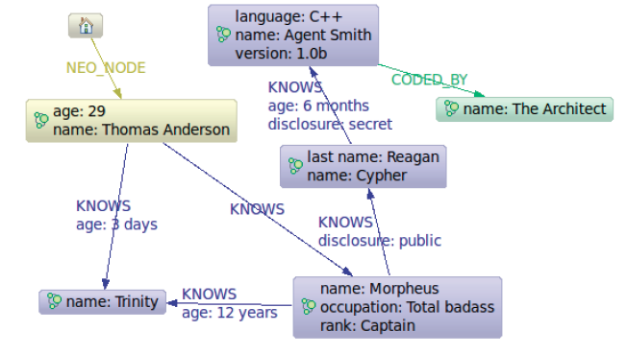
The Matrix Graph Database

Slide 45
https://www.youtube.com/watch?v=8jNPelugC2s

